Slide 1

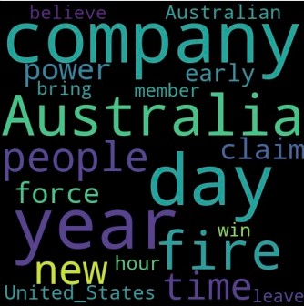
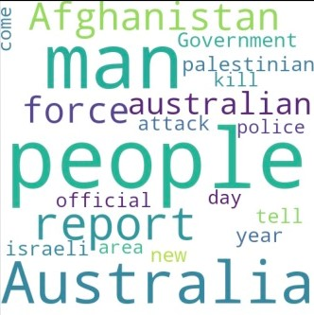
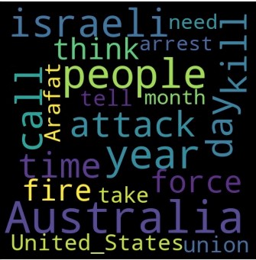
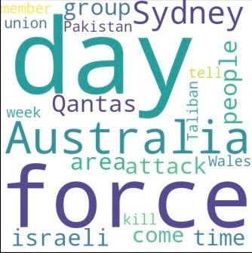
Unsupervised Word-level Association and Text Clustering
Unsupervised Machine Learning ,DS5230
David Brady
Zhewen Zhang, Hongyang Wang, Zhengyan Shi
Notes:
We designed this template so that each member of the project team has a set of slides with its own theme. Members, here’s how you add a new slide to just your set:
Mark where you want to add the slide: Select an existing one in the Thumbnails pane, click the New Slide button, then choose a layout. The new slide gets the same theme as the other slides in your set.
Careful! Don’t annoy your fellow presenters by accidentally changing their themes. That can happen if you choose a different theme from the Design tab, which changes all of the slides in the presentation to that look.

Slide 2
Agenda / Topics
Project Description
Project Methodology
Performed Data Preprocessing
Process details
Conclusion

Slide 3
Project Description
Background
Description
Natural Language Processing is a common technique nowadays. We usually think of it as a supervised learning system with a labeled training set.
With the idea of doing something different, in this project we try to use unsupervised learning methods to do topic modeling.
Using spaCy to clean up text data
Using Apriori to build Association Rules
Using kmeans to do Clustering Analysis
Building Latent Semantic Indexing model
Building Hierarchical Dirichlet Process model
Building Latent Dirichlet Allocation model

Slide 4
Procedure/Methodology
Two languages used, R and python. And used the following packages (not limited to)spacy, gensim, matplotlib.pyplot, sklearn, keras, nltk, arules(R)
Performed data preprocessing, calculated K-means, searched for association rules, and performed modeling of LSI, HDP, and LDA
LSI - Implements fast truncated SVD (Singular Value Decomposition). The SVD decomposition can be updated with new observations at any time, for an online, incremental, memory-efficient training
HDP - A nonparametric Bayesian approach to clustering grouped data. It uses a Dirichlet process for each group of data, with the Dirichlet processes for all groups sharing a base distribution which is itself drawn from a Dirichlet process
LDA - A generative statistical model that allows sets of observations to be explained by unobserved groups that explain why some parts of the data are similar

Slide 5
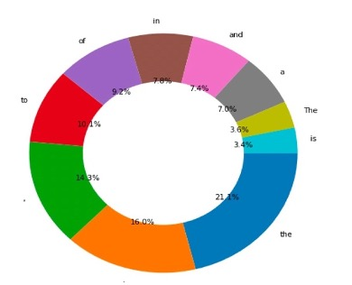
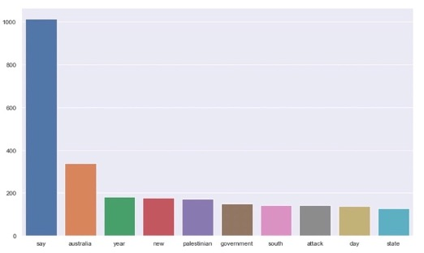
Performed Data Preprocessing
Data Sources
Before
After
Lee Background Corpus. The text corpus evaluated by human judges contained 50 documents selected from the Australian Broadcasting Corporation’s news mail service, which provides text e-mails of headline stories. The documents varied in length from 51 to 126 words and covered several broad topics.

Slide 6
Association rules

Slide 7
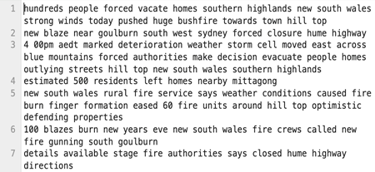
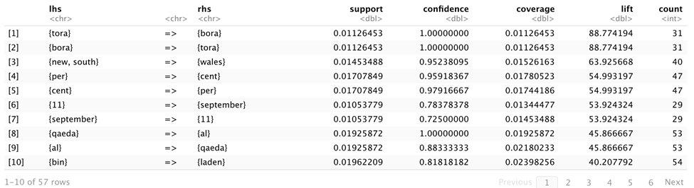
Association rules
Preparatory data work
Association rules
According to the results, September with 11th and (new, south) with wales are likely to appear at the same time --- are reasonable.

Slide 8
Clustering Analysis
K-means

Slide 9
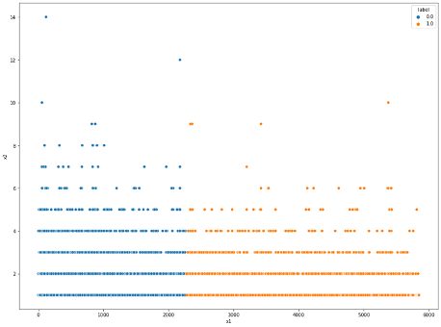
K-means
K-means on the raw data
The original data is transferred to a 22245*2-dimensional array list, and then we use MinMax to normalize it. The Silhouette Score and CH Index Evaluation of the Best Number of Clusters
K-means on the cleaned data
Based on the Silhouette Scores above, we classify the corpus data into two clusters using
The original raw data is spat into two clusters and it will be harnessed as a baseline function to be compared with the final evaluation after LDA and LSA in topic modeling.

Slide 10
Data modeling

Slide 11
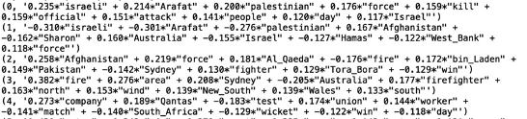
LSI – Latent Semantic Indexing
Also known as LSA(latent semantic analysis), is a mathematical implementation which helps classify and retrieve information on key phrases and concepts by using SVD. Through singular value decomposition, a matrix containing word counts per document is constructed in order to reduce dimension while preserving the similarity structure among columns. In this project we set the number of n equals to 5.

Slide 12
LSI – Latent Semantic Indexing
Here are the key words for each topic for us to compare in the end

Slide 13
LDA – Latent Dirichlet Allocation
Latent Dirichlet allocation (LDA) is a generative statistical model that allows observations to be explained by unobserved groups.
Hypothesis 1: Each document is a mixture of a small number of topics
Hypothesis 2: Each word's presence is attributable to one of the document's topics

Slide 14

LDA – Latent Dirichlet Allocation
We conclude the process like :
1. Select a document $d_{i}$ according to the prior probability ${p(d}_{i})$
2. Sampling from the Dirichlet distribution $α$to generate the topic distribution $θ_{i}$of the document $d_{i}$, the topic distribution $θ_{i}$ is generated by the Dirichlet distribution with the hyperparameter $α$
3. Sampling from the topic’s polynomial distribution $θ_{i}$ to generate the document $d_{i}$’s the j-th word’s topic $z_{i,j}$
4. Sampling from the Dirichlet distribution $β$ to generate the word distribution $φ_{z_{i,j}}$ corresponding to the topic $z_{i,j}$, the word distribution $φ_{z_{i,j}}$is generated by the Dirichlet distribution with the parameter $β$
5. Sampling from the polynomial distribution $φ_{z_{i,j}}$ of words and finally generating words $ω_{i,j}$

Slide 15
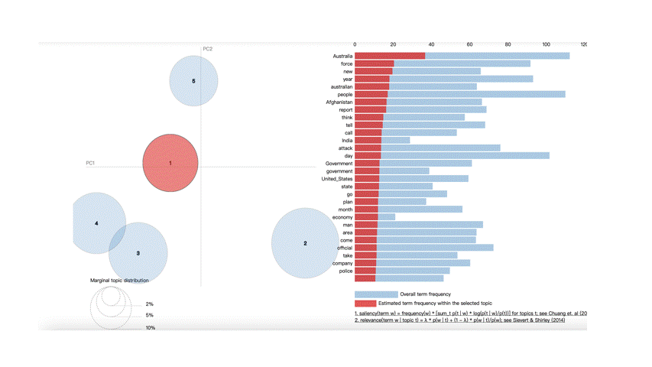
LDA – Latent Dirichlet Allocation
Top words in topic1: australia, force, new, year
Top words in topic2: israeli, palestinian, official
Top words in topic3: arrest, government, tell
Top words in topic4: force, new
Top words in topic5: area, Sydney

Slide 16
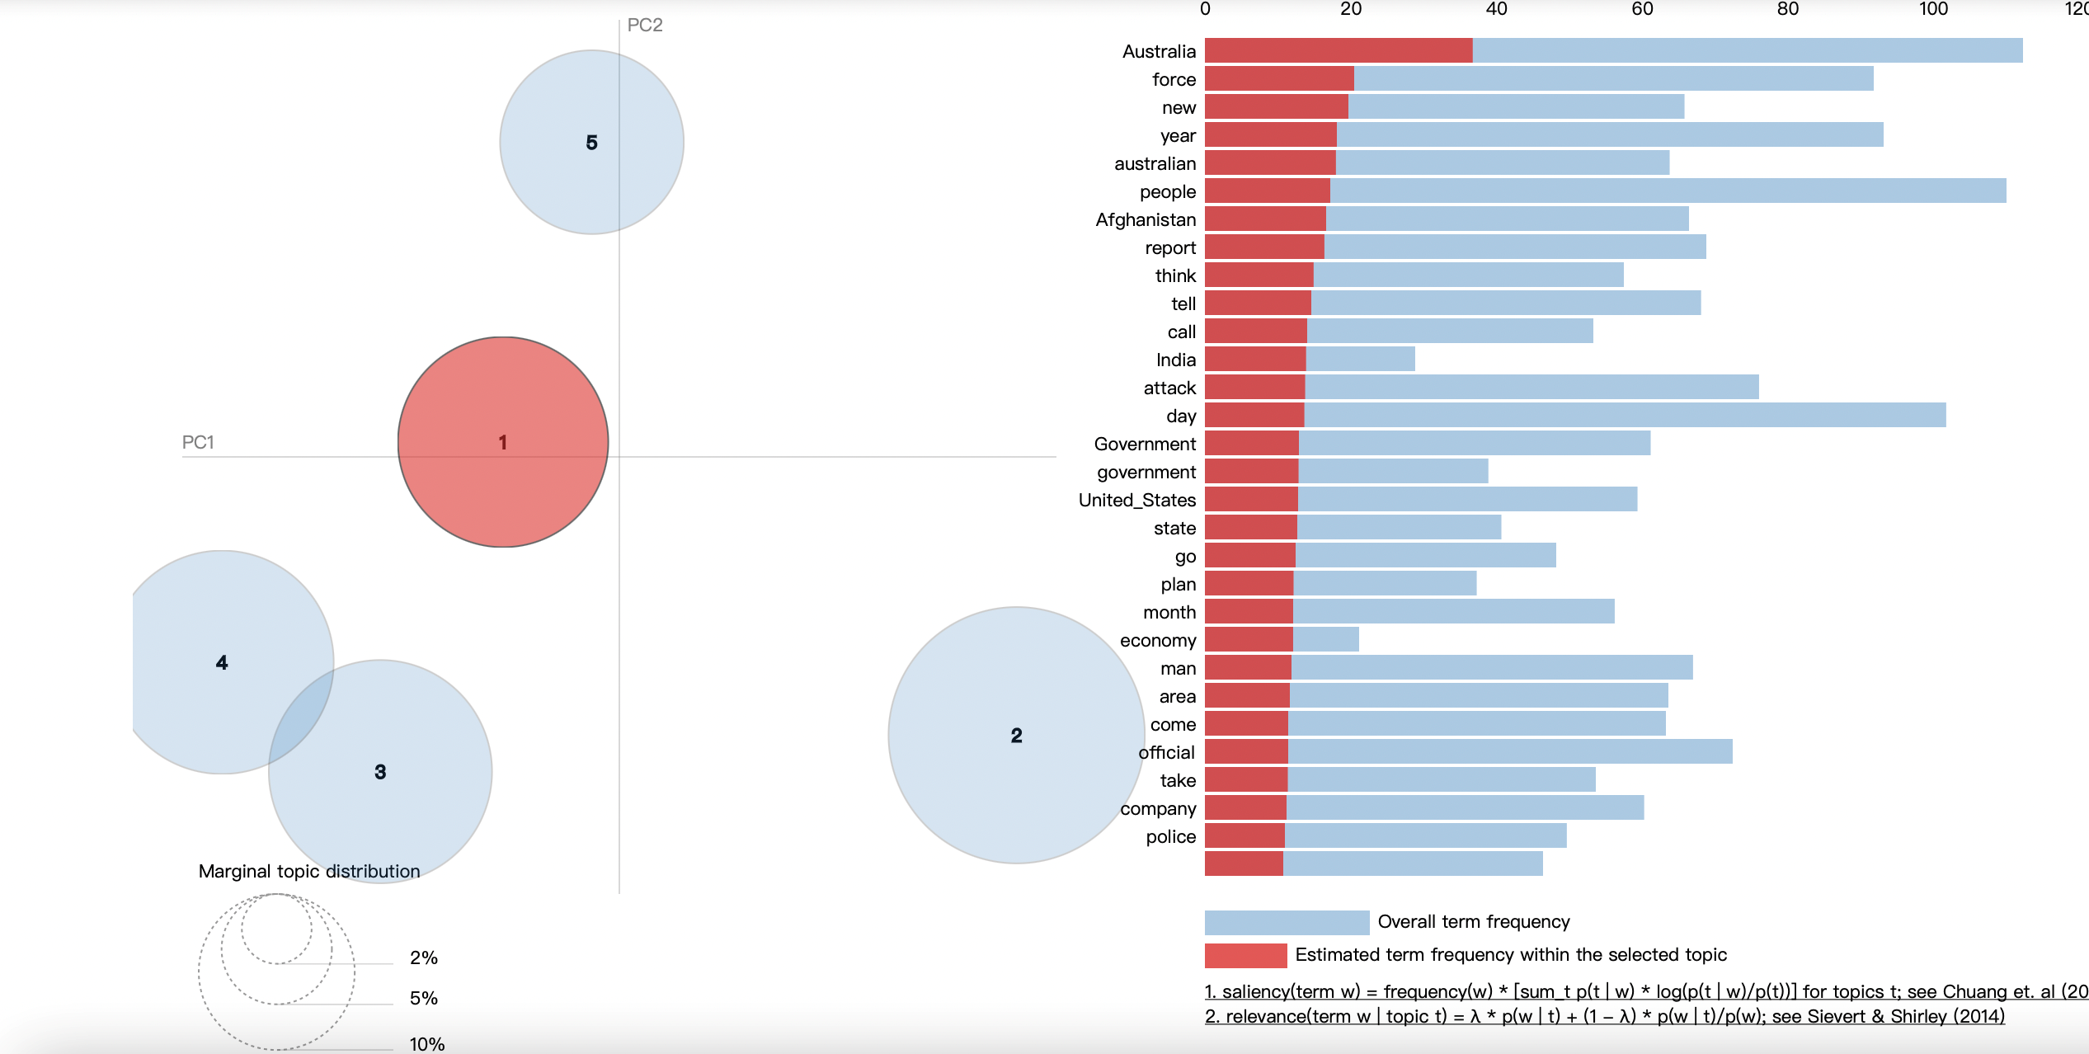
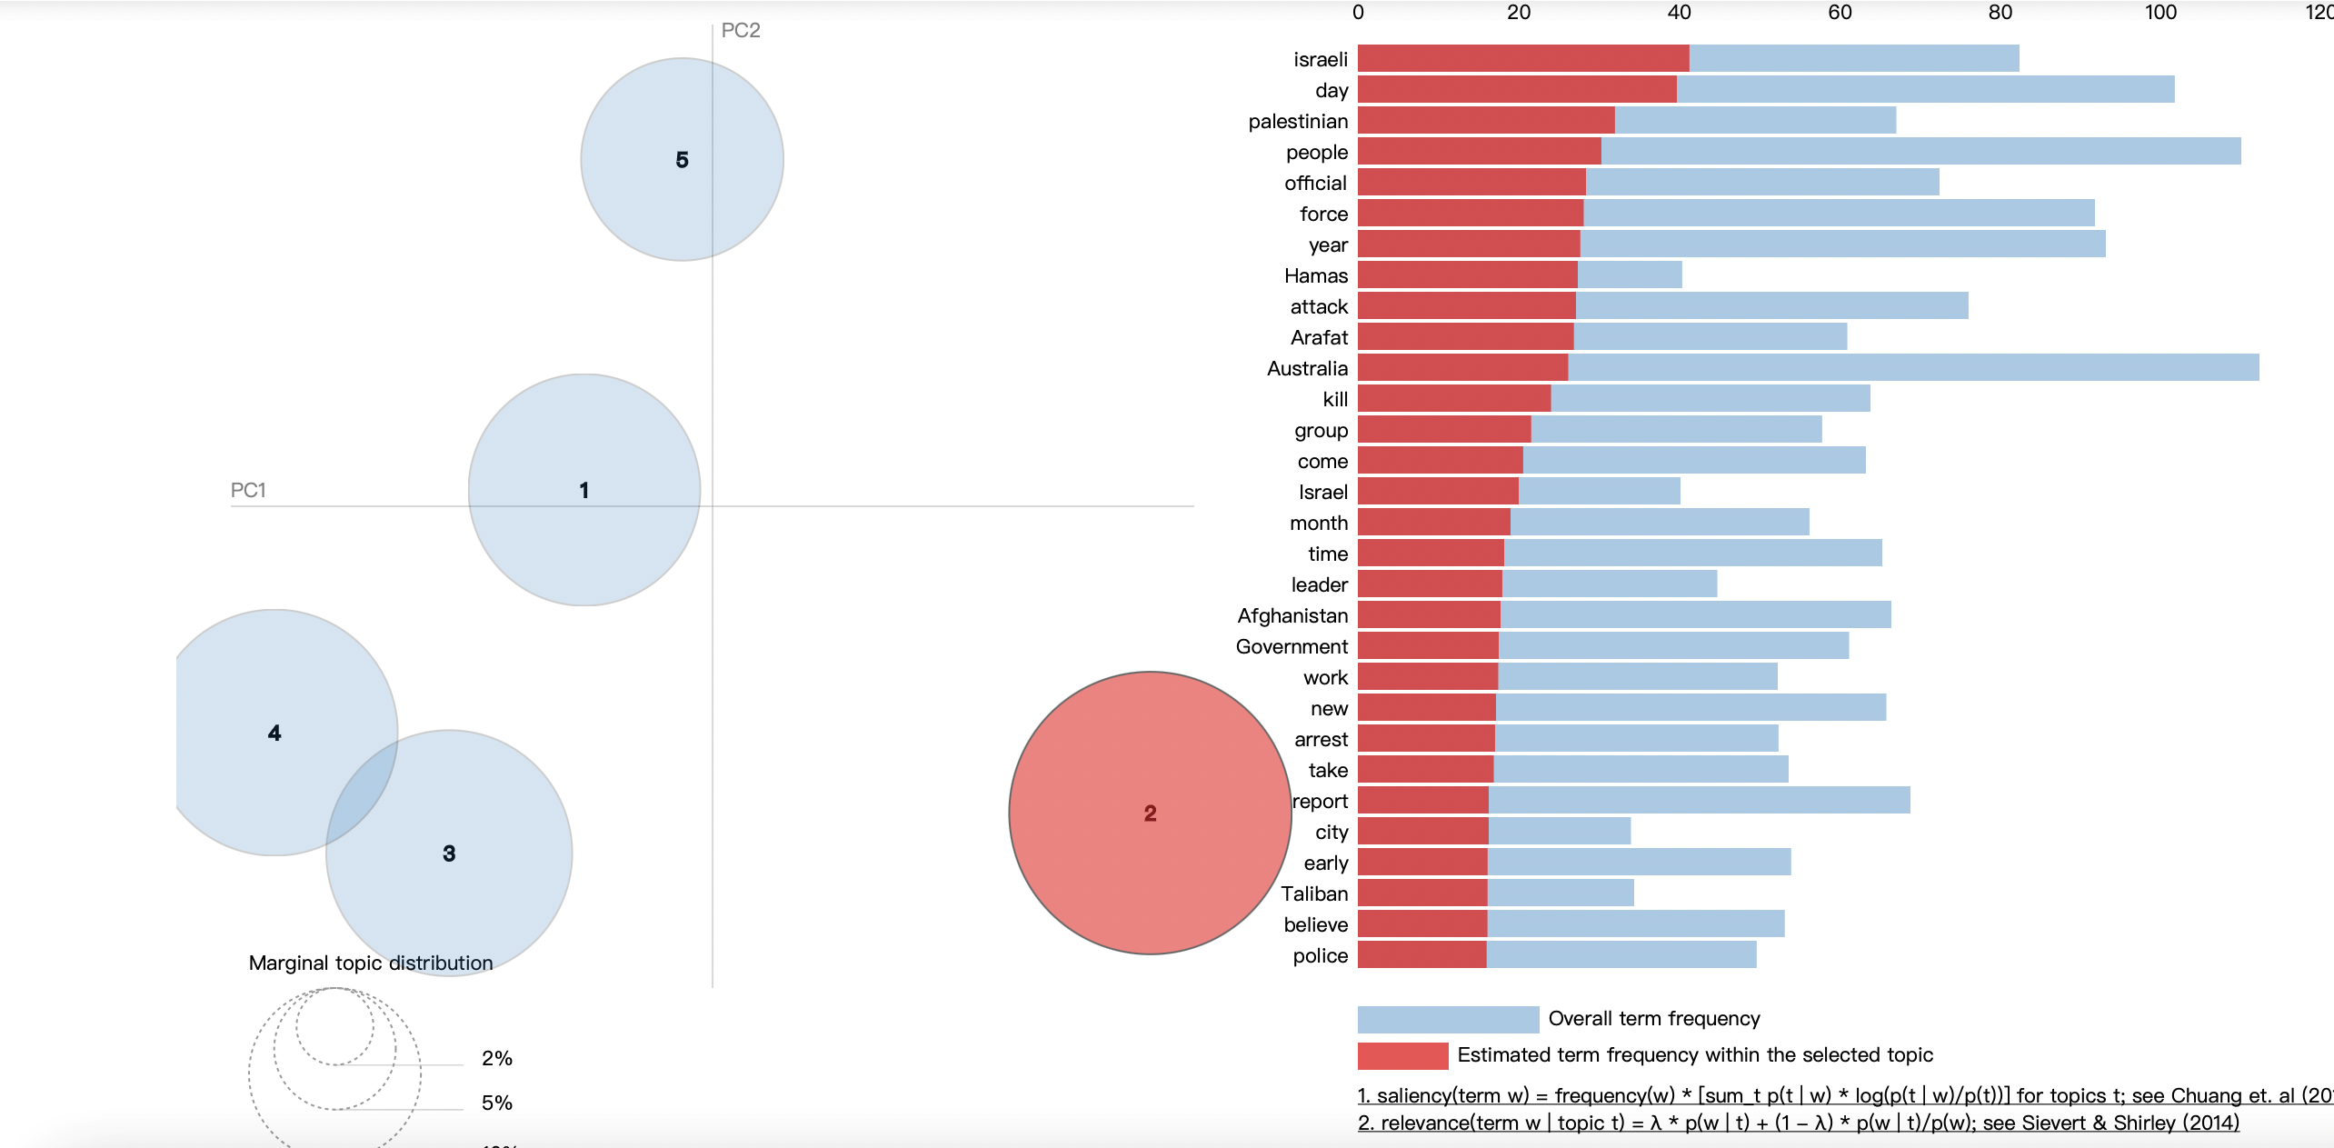
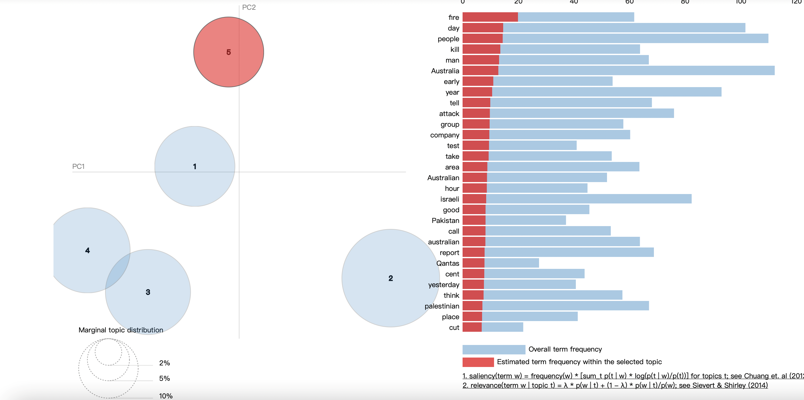
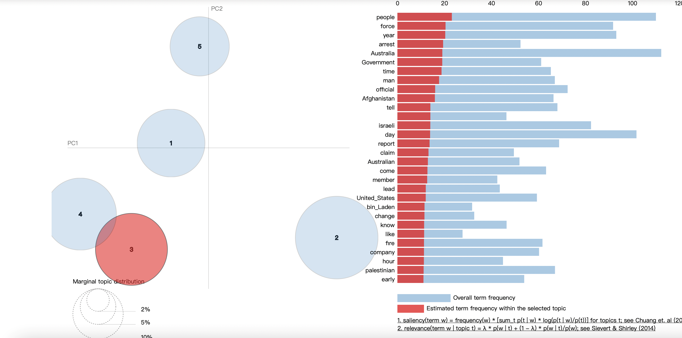
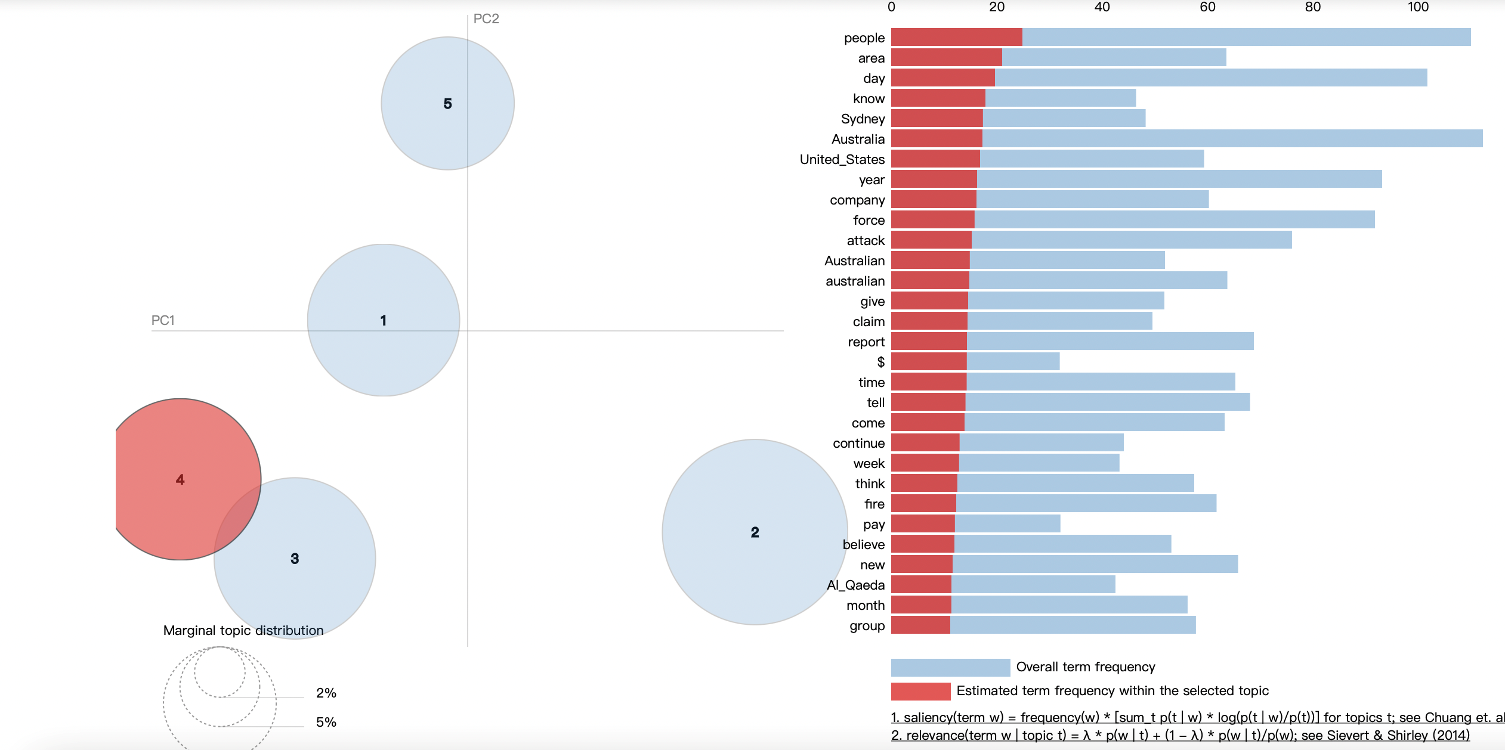
LDA – Latent Dirichlet Allocation

Slide 17
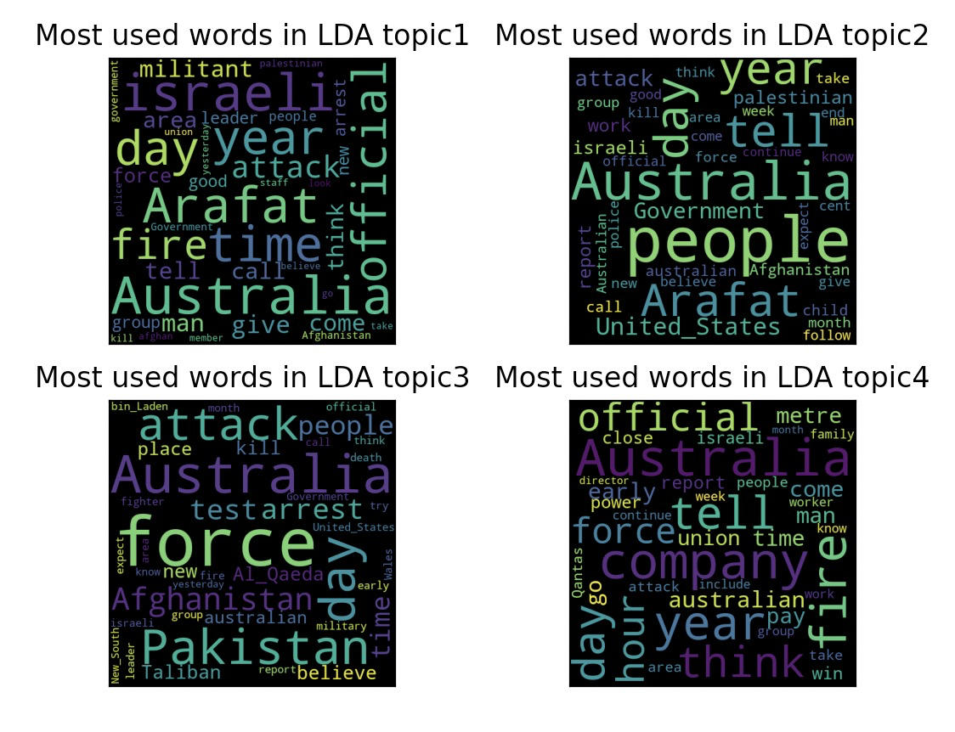
LDA – Latent Dirichlet Allocation
Here are the visualization examples of word cloud of topic from 1-4.
It's more intuitive to see that many words appear frequently in more than 1 topics like 'Australia' and 'day'. But the unique features are like 'militant', 'force', 'official' are relatively representative of each topic.
However, the unnecessary words account for too much.

Slide 18
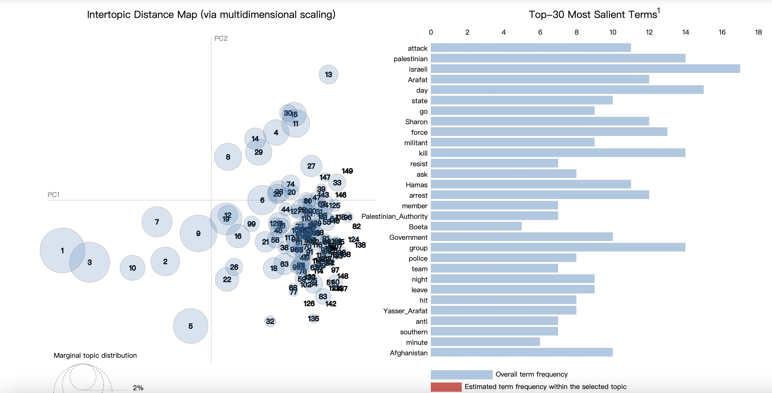

HDP – Hierarchical Dirichlet Process

Slide 19
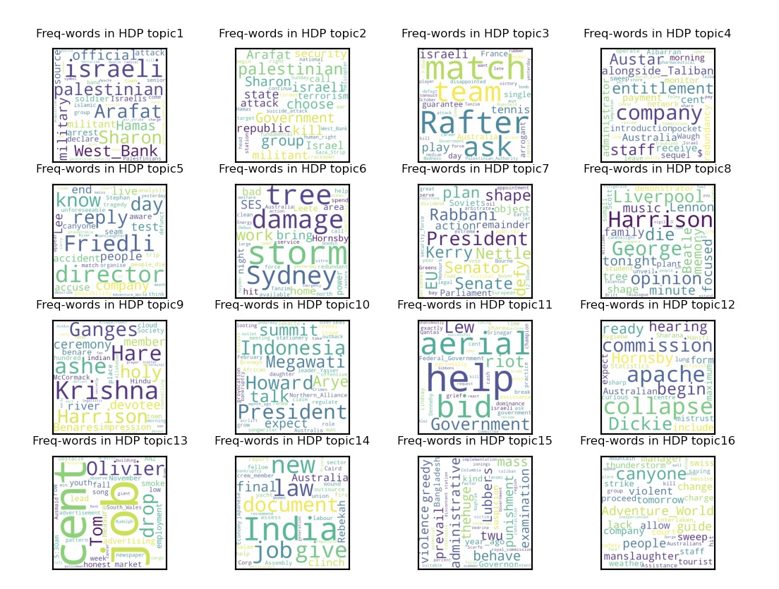

HDP – Hierarchical Dirichlet Process

Slide 20
Project Summary

Slide 21
Conclusion
In EDA, we performed data preprocessing, obtained effective association rules through calculation, and successfully performed cluster analysis using K-means. In the topic classification model, HDP is more intelligent in determining the number of clusters and generating high-frequency words (it can hide meaningless high-frequency words. For example, the results of LDA and LSI have a large proportion of the names of some countries. And the HDP results will hide these and give more meaningful results.) In general, our project has reached our expected results.

Slide 22
Thank You for Your Time
work cited
https://www.kaggle.com/faressayah/text-analysis-topic-modelling-with-spacy-gensim

